Slide 1
West’s Road to No.1
A tactical framework to deliver in 2020
Meshach Maichibi
December, 2019

Slide 2
Road to number1 – Delivering beyond the Base
Outperform
“Grow”
2020+
- FOT Export line sabotage
- TRP leak
- 1-0-1 & Must Wins
- Safety Leadership/Boost
- 1-0-1 & Must Wins
- Back to Basics
- Bad Actor & Vulnerabilities
- Task Zero / TRP /TEP leaks
- Projects - FYIP/SSAGS/ESCB
- EA FOD
- Corrosion Mgt. – Estuary B/Lines
- Well Integrity (Red Wells)
- EA Symp leg repairs
-12 Forcados W/o wells
- Otumara Compressor Reliability
- 1-0-1 & Must Wins
- TRP Availability/Task Zero
- FYIP Step 1C (12) Wells
- SSAGS step 2 (6 Tunu) Wells
- FYIP/SSAGS/ESCB-NGC
- EA FOD
- Firm Domgas sales agreement
- Otumara Opt./Compr. Reliab.
- Sand Management
- Corrosion Management
- Well Integrity (Red Wells)
- FOT power supply to N/Bank
- HA/HI – Post DG3
“Reset”
2019
“Survival”
2016 - 2018
Enablers : People, Integration, Performance Management & Organizational Effectiveness

Slide 3
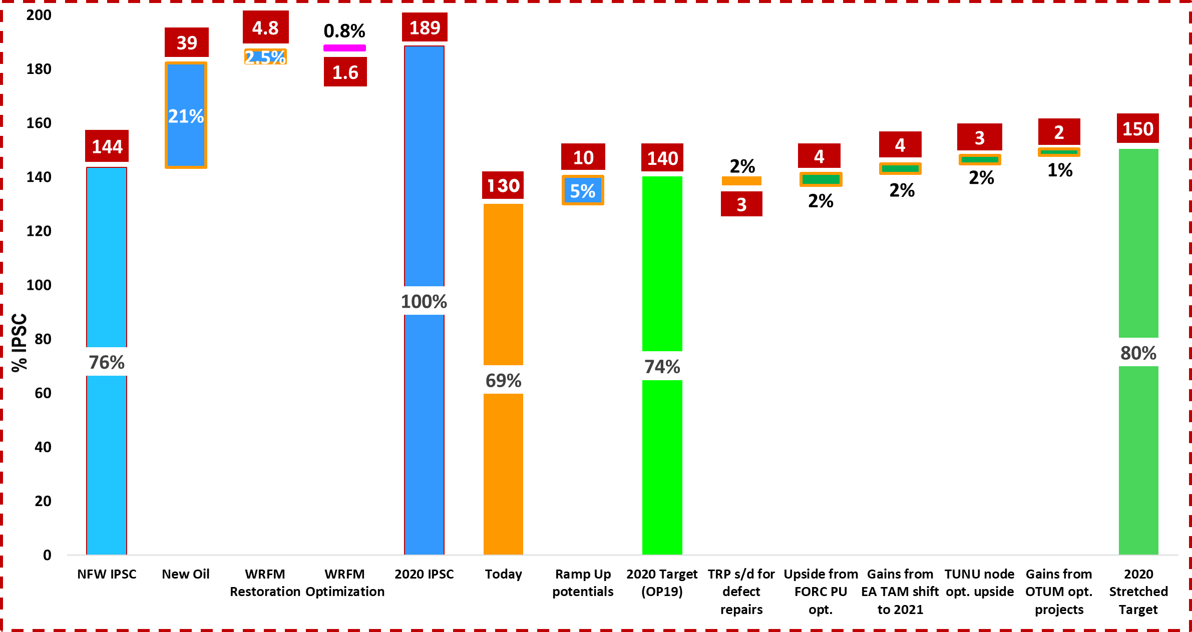
Discipline
Integration
West in 2020 – Liquid Availability, IPSC and Production
Opening up of
closed-in wells
across the nodes
plus Tunu
Condensate
ramp up
Production scale-up
IPSC build up
In 2020, we will;
Stabilize, attack bad actors & add extra 10Kbopd
Be more disciplined with plan interruptions / injections
Grow availability - West 10% and SPDC 3%
Leverage RF improvement & optimization opportunities
Generate more FCF for the business
Deliver the above & more; safely, responsibly and ethically.
Cash engine of the organization

Slide 4
West is Oil
Oil is Cash
West in 2020 – A tactical ramp up plan to 150Kbopd (Option1)
AMS, CI, Digitalization & People

Slide 5
West is Oil
Oil is Cash
West in 2020 – A tactical ramp up plan to 160Kbopd (Option2)
AMS, CI, Digitalization & People

Slide 6
West is Oil
Oil is Cash
West in 2020 – A tactical ramp up plan to 165Kbopd (Option3)
AMS, CI, Digitalization & People

Slide 7
West in 2020 – Quarterly outlook & key delivery levers (170Kboepd)
Accountability
Ownership
Stabilize - Simplify - Support

Slide 8
West in 2020 – Monthly Oil & Gas split by PU (170Kboepd)
Focus
Speed
Demonstrate vulnerability, eliminate Bad actors & Improve

Slide 9






2020 “Must Wins” – SPDC WEST
Integrated delivery, Safely, responsibly and profitably
Achieving our Fit for the Future ambition “One team - Goal Zero - $1bn Cash”
GOAL ZERO
PRODUCTION
GROWTH
CASH
Zero Harm Zero Leaks Zero E&C
Asset integrity
Zero Tier 1 & 2
Zero “high risk wells”
Zero “Red Wells”
Corrosion to “0.1”
Transform Logistics
Embed “Task Zero”
GHG reduction
Oil: 0.22t/t
Gas: 0.06t/t
Safe & reliable
DCQ every day
Oil 140 kb/d
Export 16 MMscf/d
Domgas 36 MMscf/d
OP to IAP/ MSC:
Safely execute 3 + 0 rigs
Infill & WRFM Ramp up towards “13 spreads”
New Oil 36 kb/d*
Comp Uptime >90%
*Includes 12 kb/d from FYIP – 1C
Keep T1-6 full & deliver T7 supply
HA DG3 Mar
H Expl DG4 Nov
HI FID Dec
Grow demand & deliver projects
FYIP NAG OSD Feb
Grow liquids & keep hubs full
EA FOD OSD Jan
SSAGS2 OSD Mar
JK Spud Mar
EA FOD hookup Aug
CFFO $1bn FCF $0.9 bn
Improve Opex
Capex discipline
Reduce overdues
Funding, cash mgt
People & Organizational Effectiveness
Improved Office Environment
Improved Field Logistics Bases
Employee Engagement at TQ, Deepen People Development
Implement OER Gamechangers (incl. AMS)
Safety leadership “Engaging differently”/ Embed Performance Leadership
Team Leadership

